Slide 1
QA for AuAu 200 GeV Run14 PicoDst SL22c
Diptanil Roy
Hard Probes

Slide 2
Operational Details
Track-Tower Matching in PicoDsts for AuAu 200 GeV Run 14 produced with SL18f library incorrect
Need to produce a consistent MB sample with correct information
SL22c used for the latest production
Production: P16id
Temporary filelist available at: /star/data14/GRID/NFS_FileList/AuAu_200_production_lowmid_2014_physics_P16id.SL22c.txt
Equivalent filelist in SL18f at: /gpfs01/star/pwg/droy1/STAR-Workspace/D0Analysis/AuAu/AuAu_200_production_lowmid_2014_physics_P16id.SL18f.txt
Production Parameters:
Run14 AuAu 200 GeV st_physics with HFT, P16id mtdMatch y2014a picoDst PicoVtxMode:PicoVtxVpdOrDefault TpcVpdVzDiffCut:3 PicoCovMtxMode:PicoCovMtxWrite
Current Test Dataset size: 25 % (260 million events) of total low and mid luminosity dataset

Slide 3
SL18f v SL22c
# of events normalized distributions look similar between existing and new productions

Slide 4
SL18f v SL22c
SL18f
SL22c
# of events normalized distributions look similar between existing and new productions

Slide 5
SL18f v SL22c
SL18f
SL22c
# of events normalized distributions look similar between existing and new productions

Slide 6
SL18f v SL22c
SL18f
SL22c
Similar bands of dE/dx from TPC in both productions

Slide 7
SL18f v SL22c
SL18f
SL22c
Similar bands of mass squared from TOF in both productions

Slide 8
SL18f v SL22c
Similar bands of mass squared from TOF in both productions

Slide 9
SL18f v SL22c
1. Left Plot: Ratio of HFT Tracks over TPC Tracks (No PID) vs p_{T} shows slight difference.
2. Right Plot: Double ratio of HFT Tracks over TPC Tracks between SL22c and SL18f. Difference of 1% across p_{T} bins

Slide 10

SL18f v SL22c
1. Left Plot: Ratio of HFT Tracks over TPC Tracks (No PID) vs $η$ shows slight difference.
2. Right Plot: Double ratio of HFT Tracks over TPC Tracks between SL22c and SL18f. Ratio slightly below 1 (max ~1%).

Slide 11
SL18f v SL22c
Event by event HFT/TPC ratio for the two libraries -> Identical
The difference in the earlier plots (Slide 9-10) is from slight differences in the total event set considered.

Slide 12
SL18f v SL22c
# of events normalized distributions look similar between existing and new productions

Slide 13
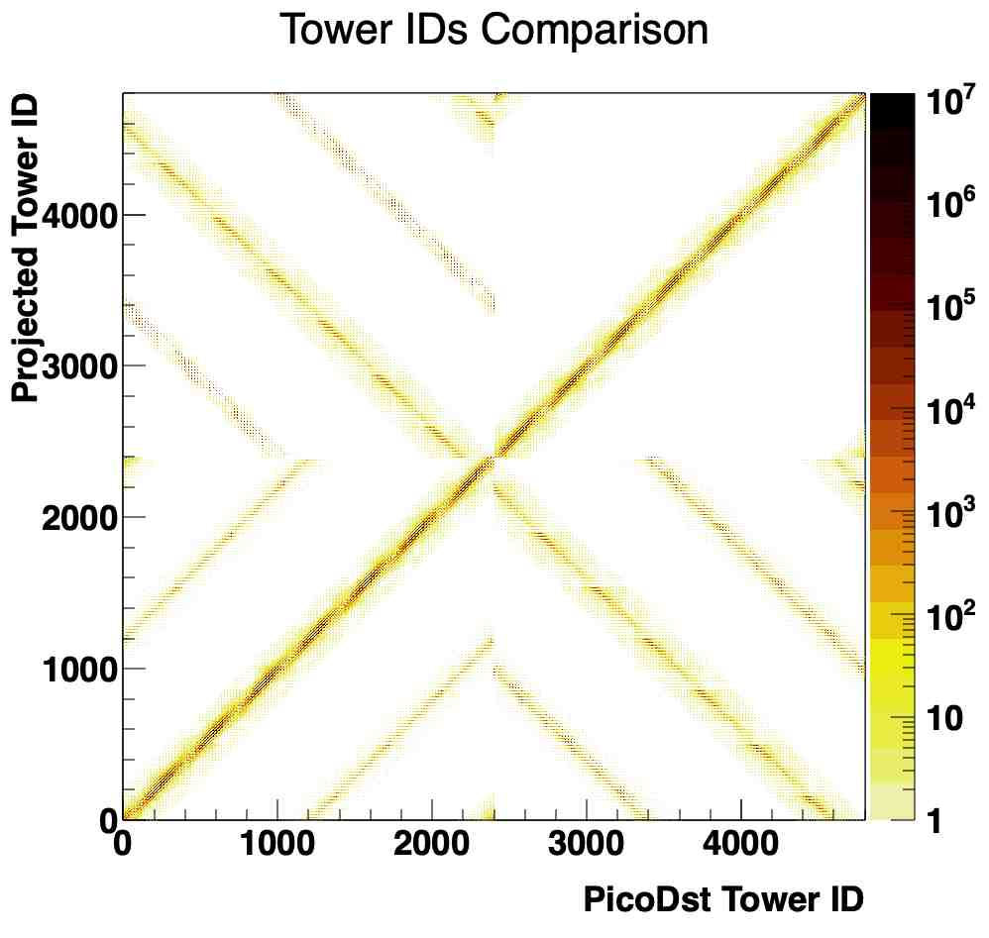
SL18f v SL22c
In SL18f, the track-tower matching was incorrect.
Approximate fix: Use DCA helix stored in picoDst to project tracks on to a tower. [Projected Tower ID]
Difference from algorithm used to do track-tower matching: Helix from mid-point (stored in MuDst) instead of DCA used to project tracks on to tower
Difference is most prominent for low p_{T} tracks [See next slide]

Slide 14
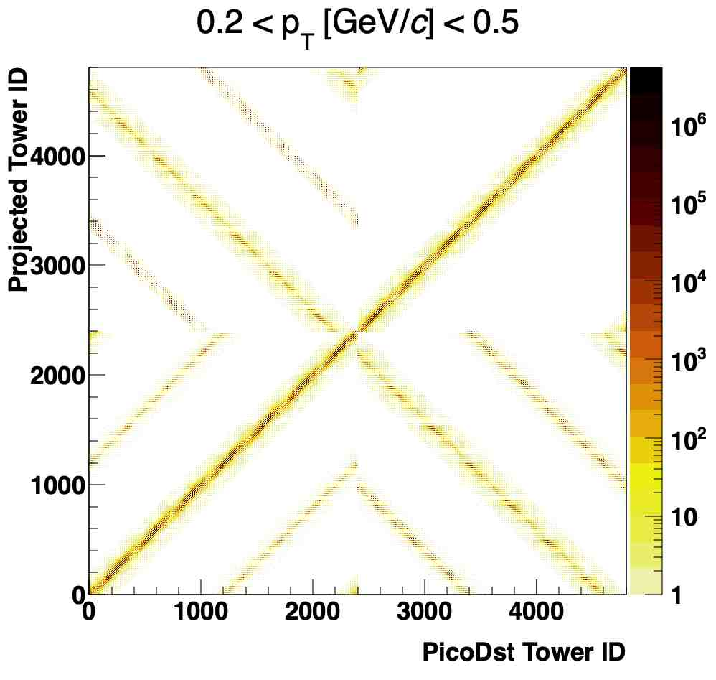
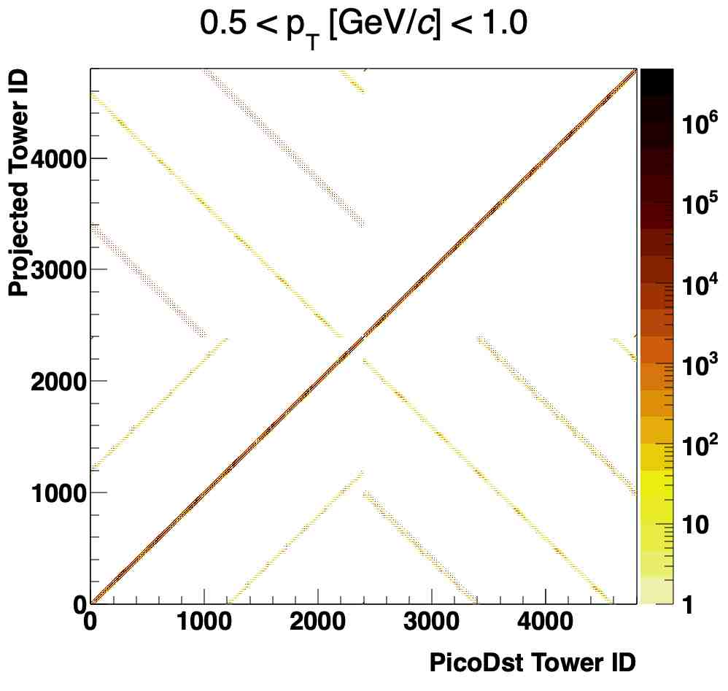
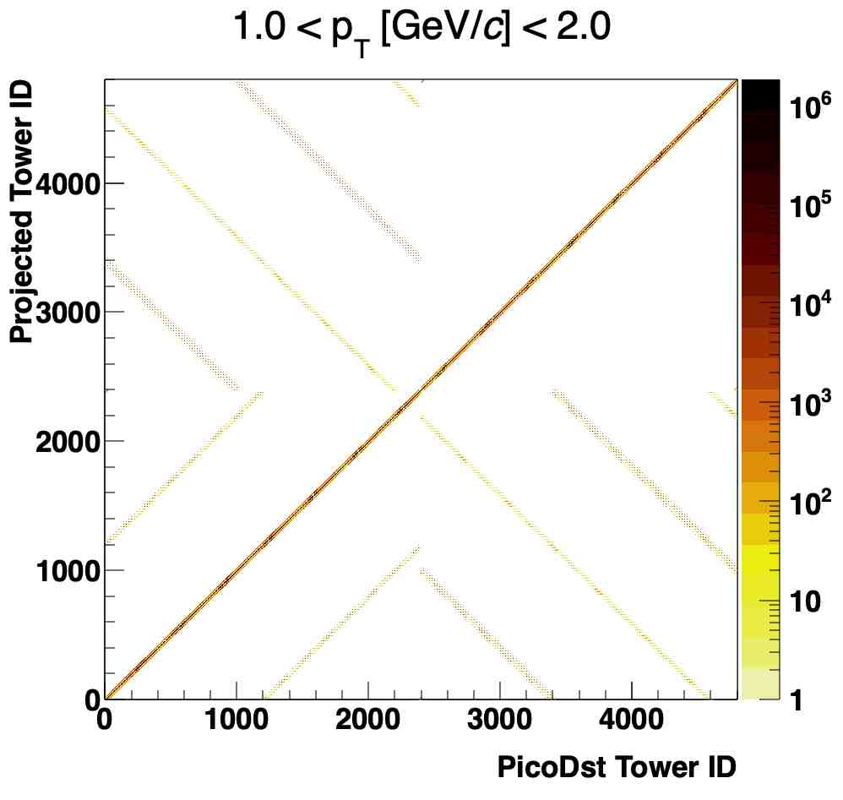
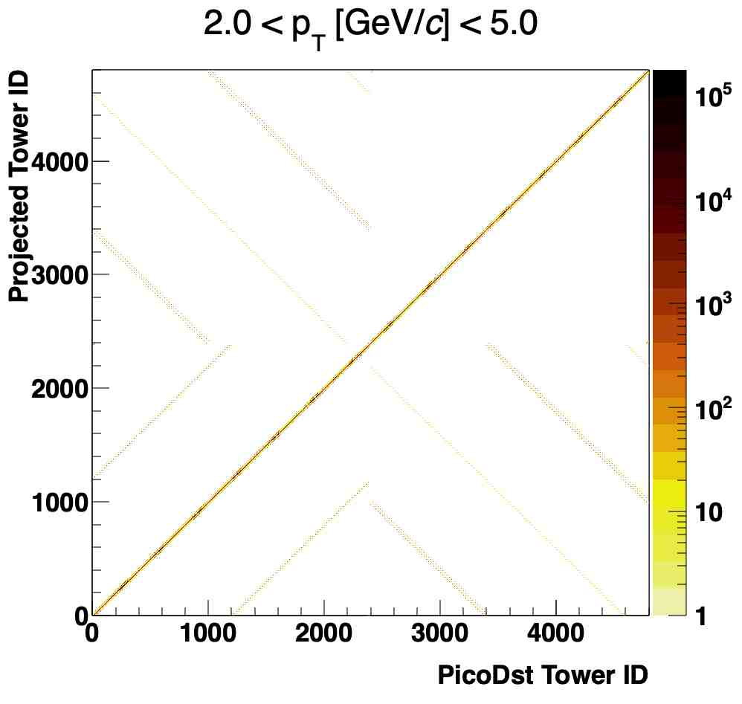
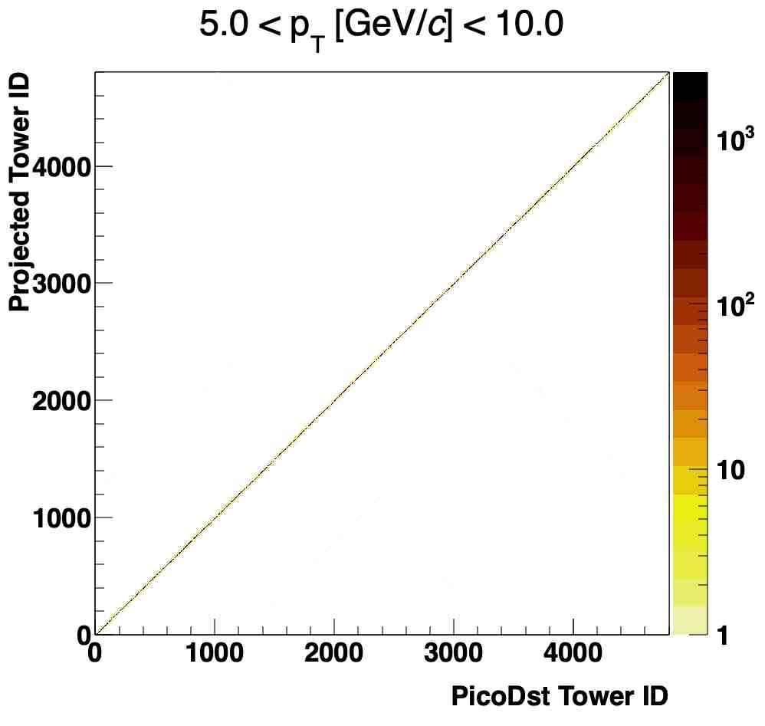
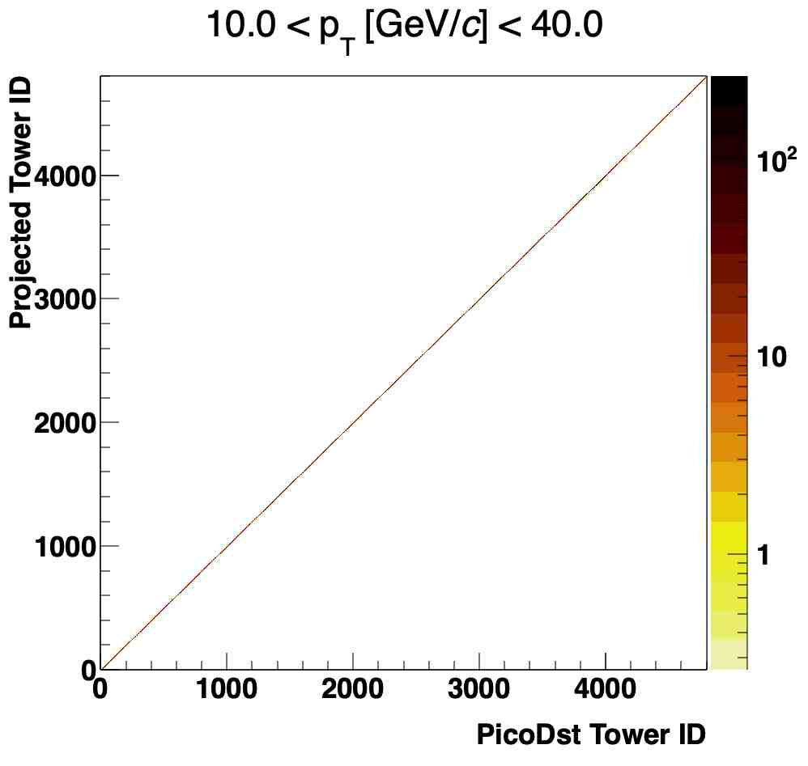
SL18f v SL22c
Difference between actual tower hit and approximate projection is acute in low p_{T}, and disappears at high p_{T}

Slide 15
Conclusion
Overall, good agreement between the two productions (SL18f and SL22c) on the tracking and PID info. Tower hits look nominal as well.
Track-tower matching information exists exists in new sample.
Tracking between HFT and TPC are identical with the two libraries.

